Slide 1
Week 9 Inheritance
Dr Lewis Evans
Email: L.Evans@mmu.ac.uk
Office: E112
Office Hours:
Thursday: 10-11am
Friday: 9-11am

Slide 2




Outline
Object-oriented analysis and design
Inheritance
Abstract Classes

Slide 3

Learning Objectives
Previously
We have already used classes and objects
Top-down design for procedures/functions – object-oriented design is a higher-level process for organising data and code
This Lecture
Analysing a problem to design an object-oriented solution
Inheritance
UML Class Diagrams

Slide 4
Object-Oriented Programming
Object-oriented (OO) programming decomposes a problem into objects which are collections of data (fields or attributes) and behaviour (methods – procedures and functions)
Provides a ‘natural’ view of the world, where data is encapsulated with methods for its manipulation
An OO program is a collection of objects of different types, interacting through the object methods
Key advantage of good OO design is reusability (code is easily reused in new projects)

Slide 5

(Cambridge Halls, Manchester Met)

Slide 6
Data
name
dob
degree
name
dob
degree
name
dob
degree
(Cambridge Halls, Manchester Met)

Slide 7
Methods
study()
sitExam()
sleep()
study()
sitExam()
sleep()
study()
sitExam()
sleep()
(Cambridge Halls, Manchester Met)

Slide 8
Object
Student
name
dob
degree
study()
sitExam()
sleep()

Slide 9
System
Student
Student
Student
Student
Student
Student
Student
name
dob
degree
Student
Student
name
dob
degree
name
dob
degree
Student
Student
name
dob
degree
name
dob
degree
Student
Student
name
dob
degree
name
dob
degree
Student
Student
name
dob
degree
name
dob
degree
Student
Student
name
dob
degree
name
dob
degree
Student
Student
name
dob
degree
name
dob
degree
study()
sitExam()
sleep()
Student
name
dob
degree
Student
study()
sitExam()
sleep()
name
dob
degree
study()
sitExam()
sleep()
Student
name
dob
degree
Student
study()
sitExam()
sleep()
name
dob
degree
study()
sitExam()
sleep()
Student
name
dob
degree
Student
study()
sitExam()
sleep()
name
dob
degree
study()
sitExam()
sleep()
Student
name
dob
degree
Student
study()
sitExam()
sleep()
name
dob
degree
study()
sitExam()
sleep()
Student
name
dob
degree
Student
study()
sitExam()
sleep()
name
dob
degree
study()
sitExam()
sleep()
Student
name
dob
degree
Student
study()
sitExam()
sleep()
name
dob
degree
study()
sitExam()
sleep()
Student
name
dob
degree
Student
study()
sitExam()
sleep()
name
dob
degree
study()
sitExam()
sleep()
Student
name
dob
degree
Student
study()
sitExam()
sleep()
name
dob
degree
study()
sitExam()
sleep()
Student
name
dob
degree
Student
study()
sitExam()
sleep()
name
dob
degree
study()
sitExam()
sleep()
Student
name
dob
degree
Student
study()
sitExam()
sleep()
name
dob
degree
study()
sitExam()
sleep()
Student
name
dob
degree
name
dob
degree
study()
sitExam()
sleep()
study()
sitExam()
sleep()
name
dob
degree
name
dob
degree
study()
sitExam()
sleep()
study()
sitExam()
sleep()
name
dob
degree
name
dob
degree
study()
sitExam()
sleep()
study()
sitExam()
sleep()
name
dob
degree
study()
sitExam()
sleep()
study()
sitExam()
sleep()
study()
sitExam()
sleep()
study()
sitExam()
sleep()
study()
sitExam()
sleep()
study()
sitExam()
sleep()
study()
sitExam()
sleep()
study()
sitExam()
sleep()
study()
sitExam()
sleep()
study()
sitExam()
sleep()
study()
sitExam()
sleep()
study()
sitExam()
sleep()
study()
sitExam()
sleep()

Slide 10
UML Class Diagrams
It is helpful to have a way of visualising a class and what that class has without having to get bogged down into looking at code
The Unified Modelling Language (UML) helps us here
UML is a formal, graphical language used to express object-oriented designs and business process models
Many types of UML diagrams – the one below is a UML Class Diagram
Student
name : String dob : String degree : String
study( subject : String ) : void sitExam() : void sleep( length : int ) : void
Class Name (Bold and centred)
Class Data / Attributes (with types)
Class Methods (with return and parameter types)

Slide 11
Analysis
How do we establish which types of object we might need in a given situation?
Analysis: Determining the fundamental components of a system

Slide 12
Building a Model
Given a description of a system, how do we extract the important components?
First, underline all of the nouns
These will identify the initial set of classes
Identify duplicates and redundancies, and cross them out
Look for anything that could be an attribute/method of an existing class, rather than a class in its own right
Verbs generally correspond to methods; any words following “has/have” are generally attributes

Slide 13
Example
A bank stores details of customer accounts. Each customer has a name and an address, and may hold one or more accounts. Every account has a basic balance, but accounts may be one of several types: investment, saving or current. A saving account has an interest rate associated with it, and a current account has an overdraft limit.

Slide 14
Redefining
A bank stores details of customer accounts. Each customer has a name and an address, and may hold one or more accounts. Every account has a basic balance, but accounts may be one of several types: investment, saving or current. A saving account has an interest rate associated with it, and a current account has an overdraft limit.
Objects
Object attributes

Slide 15
First cut: Accounts
CurrentAccount
balance : double overdraftLimit : double
SavingsAccount
balance : double interestRate : double
InvestmentAccount
balance : double
We can improve this using inheritance. Find what the classes have in common and abstract this into a base class. The three different account types can then inherit from this class, and add to it.

Slide 16
Inheritance
Account
balance : double
Superclass
In UML, inheritance is represented by the white triangle-headed arrow
Subclasses
CurrentAccount
SavingsAccount
InvestmentAccount
overdraftLimit : double
interestRate : double

Slide 17
Inheritance Terminology
A class which inherits from another is called a subclass or derived class
The class being inherited from is called the superclass or base class
Subclasses inherit all the data and methods of the superclass (they get them for free without the need to redeclare them)
A subclass can optionally override any methods of the superclass – replace with its own version (with the same name/method signature)
Inheritance represents an “is-a” relationship e.g.
Car is-a Vehicle
SavingsAccount is-an Account
Student is-a Person
Dog is-an animal

Slide 18
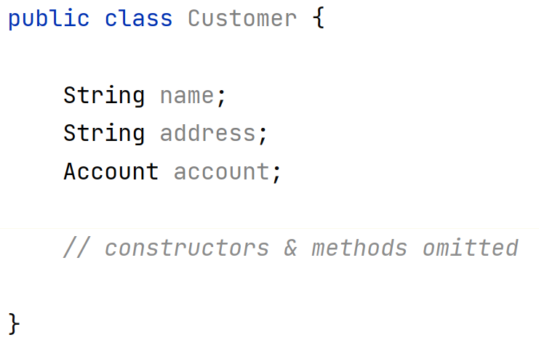
Final Design: Bank Accounts
Customer
name : String address : String
has-a
UML: white diamond
is the ‘aggregation’
symbol. Represents a
‘has a’ relationship.
Account
balance : double
is-a
CurrentAccount
overdraftLimit : double
SavingsAccount
interestRate : double
InvestmentAccount

Slide 19
Inheritance in Java
Person
name : String id : int
print() : void
We will code up this example in Java:
Student
department : String degree : String
print() : void
Academic
subject : String
print() : void
InternationalStudent
country : String
print() : void

Slide 20
Person.java
class Person {
String name;
int id;
Person(String name, int id) {
this.name = name;
this.id = id;
}
void print() {
System.out.println("Name: " + name);
System.out.println("id: " + id);
}
}
This will be our superclass – Student and Academic will both inherit from it (i.e. Student and Academic will be subclasses of Person)

Slide 21
Student.java
“is a” more specific type of..
class Student extends Person {
String department;
String degree;
Student(String name, int id, String department, String degree) {
super(name, id); // call superclass constructor
this.department = department;
this.degree = degree;
}
@Override
void print() {
super.print(); // call superclass print method (deal with name and id)
System.out.println("Department: " + department);
System.out.println("Degree: " + degree);
}
}
Inheritance in Java is expressed using the extends keyword
super is a reference to the base class (superclass)
@Override is an optional annotation to tell the compiler this is an overridden method – good practice to use it.
Note we used super twice here – once to call the constructor, and once to call the superclass’ print() method.

Slide 22

Academic.java
class Academic extends Person {
String subject;
Academic(String name, int id, String subject) {
super(name, id);
this.subject = subject;
}
@Override
void print() {
super.print();
System.out.println("Subject: " + subject);
}
}
If you are calling a superclass’ constructor, it must be the first statement within the body

Slide 23
InternationalStudent.java
class InternationalStudent extends Student {
String country;
InternationalStudent(String name, int id, String department, String degree, String country) {
super(name, id, department, degree);
this.country = country;
}
@Override
void print() {
super.print();
System.out.println("Country: " + country);
}
}

Slide 24
<<Title>>
public class Main {
public static void main(String args[]) {
Student myStudent;
Academic myAcademic;
InternationalStudent myIntStudent;
myStudent = new Student("Bob Student", 1111, "Healthcare", "Physiotherapy");
myAcademic = new Academic("Alice Lecturer", 2222, "History");
myIntStudent = new InternationalStudent("Jose Mourinho", 3333, "Sports Science", "Football Management Studies", "Portugal");
myStudent.print();
myAcademic.print();
myIntStudent.print();
}
}
myStudent : Student
myStudent
myAcademic
name = “Bob Student”
id = 1111
department = “Healthcare”
degree = “Physiotherapy”
myIntStudent
myAcademic : Academic
name = “Alice Lecturer”
id = 2222
subject = “History”
Name: Bob Student
id: 1111
Department: Healthcare
Degree: Physiotherapy
Name: Alice Lecturer
id: 2222
Subject: History
Name: Jose Mourinho
id: 3333
Department: Sports Science
Degree: Football Management Studies
Country: Portugal
myIntStudent : InternationalStudent
name = “Jose Mourinho”
id = 3333
department = “Sports Science”
degree = “Football Management Studies”
country = “Portugal”

Slide 25
Abstract Classes
Person
name : String id : int
print() : void
class Person {
String name;
int id;
Person( String name, int id) {
this.name = name;
this.id = id;
}
void print() {
System.out.println("Name: " + name);
System.out.println("id: " + id);
}
}
Student
department : String degree : String
print() : void
Academic
subject : String
print() : void
InternationalStudent
country : String
print() : void

Slide 26
Abstract Classes
When we create a class, we often do so with the intention of creating objects (instances) of that class
Earlier, we created objects to represent a Student, InternationalStudent and Academic
Could we create a Person object? Technically yes – But what exactly is a Person in the context of a university system?
We can declare the Person class as being abstract – which means the class exists solely to provide some common attributes and methods to its subclasses
We cannot create objects (instantiate) an abstract class

Slide 27
Abstract Classes
Person
name : String id : int
print() : void
Abstract Class in UML
In UML, abstract class names appear in italics
abstract class Person {
String name;
int id;
Person(String name, int id) {
this.name = name;
this.id = id;
}
void print() {
System.out.println("Name: " + name);
System.out.println("id: " + id);
}
}
abstract keyword
This class is not “specific” or “concrete” enough to create objects of
Student
department : String degree : String
print() : void
Academic
subject : String
print() : void
InternationalStudent
country : String
print() : void

Slide 28
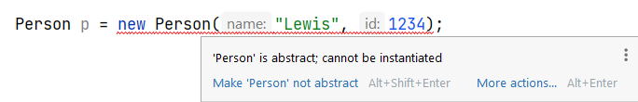
Abstract Classes
Your IDE will not let you compile your code if you attempt to create an object from an abstract class
An abstract class exists to provide common attributes and methods to its subclasses – they are not concrete enough to exist as an object

Slide 29


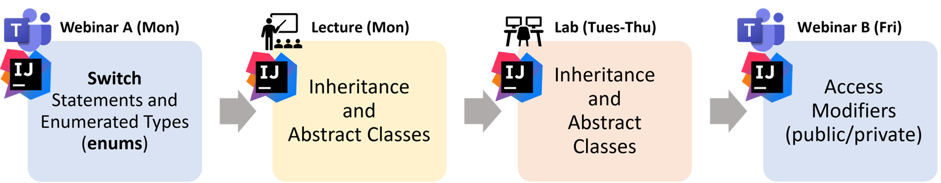
Summary
Object-Oriented Analysis & Design – an approach for analysing and designing an object-oriented solution to a problem
Inheritance
Superclass – A class that is extended by a subclass
Subclass – extends a superclass (e.g. Dog is-a Animal – Dog is subclass, Animal is superclass)
Abstract Class – a class that can be extended, but cannot be instantiated (i.e. you cannot create an object of an abstract class)

